Slide 1
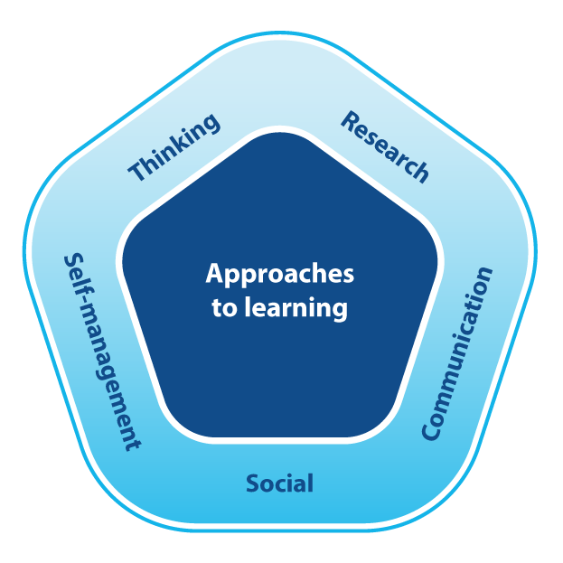
November 19 2021
Parent Workshop
Approaches to Learning (ATL) in the PYP - focus on THINKING SKILLS
By Mr Jason Barton

Slide 2
Welcome and thank you for joining us.
The Agenda -
3.30 - 4.00pm:
What are the IB Approaches
to Learning (ATL)?
What are Thinking Skills as
part of the ATL?
How do we teach thinking?
4.00 - 4.15pm: Q and A session

Slide 3
In the IBPYP we teach your children 5 broad skills which are transferable across all subjects.
When we teach THINKING we empower children to….

Slide 4
Develop Critical-thinking skills: for analysing and evaluating issues and ideas
Practice Creative-thinking skills: for generating novel ideas and considering new perspectives
Undertake Reflection: for considering the process of learning

Slide 5
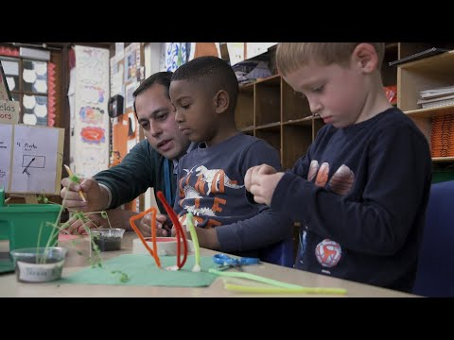
What does this teaching of thinking look like in a
PYP school?

Slide 6
As teachers what TOOLS do we use to help children become skilful at THINKING?
We use THINKING ROUTINES which are best described as a:
set of questions
or
a brief sequence of steps
used to support student thinking.

Slide 7
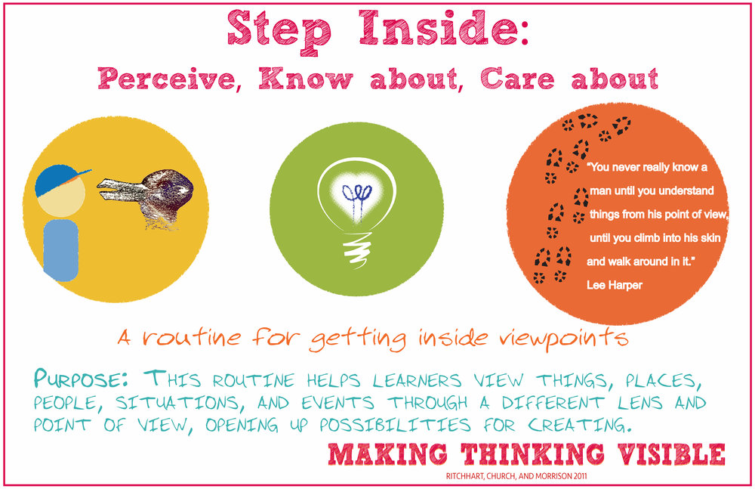

Slide 10
Where do the Routines come from?
PZ's Thinking Routines Toolbox | Project Zero
Projects: Current PZ Projects

Slide 11
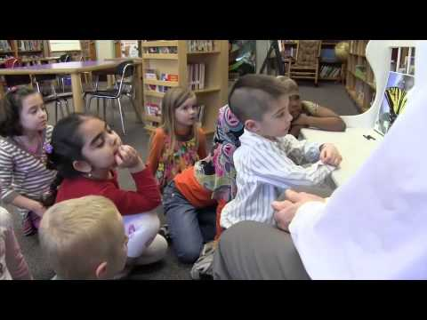
What happens to children's learning when we apply Critical Thinking as feedback?

Slide 12
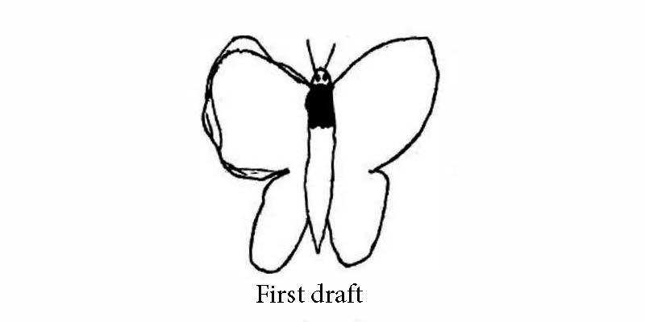

Slide 13
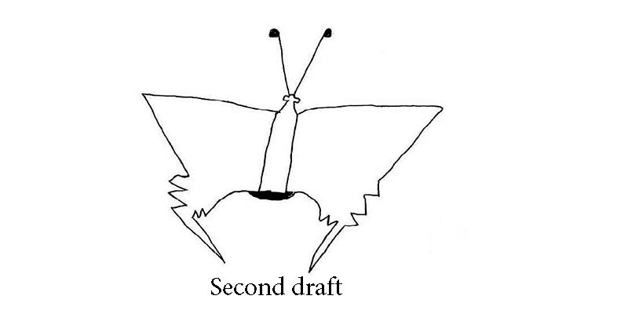

Slide 14
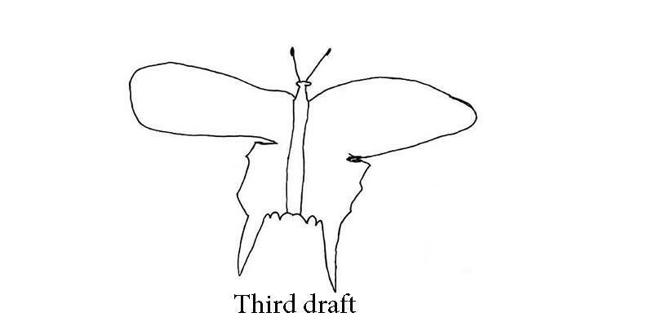

Slide 15
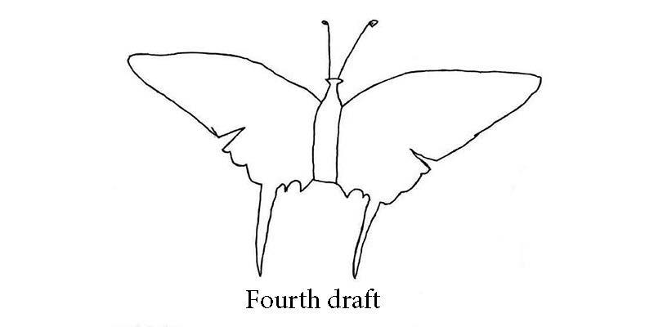

Slide 18
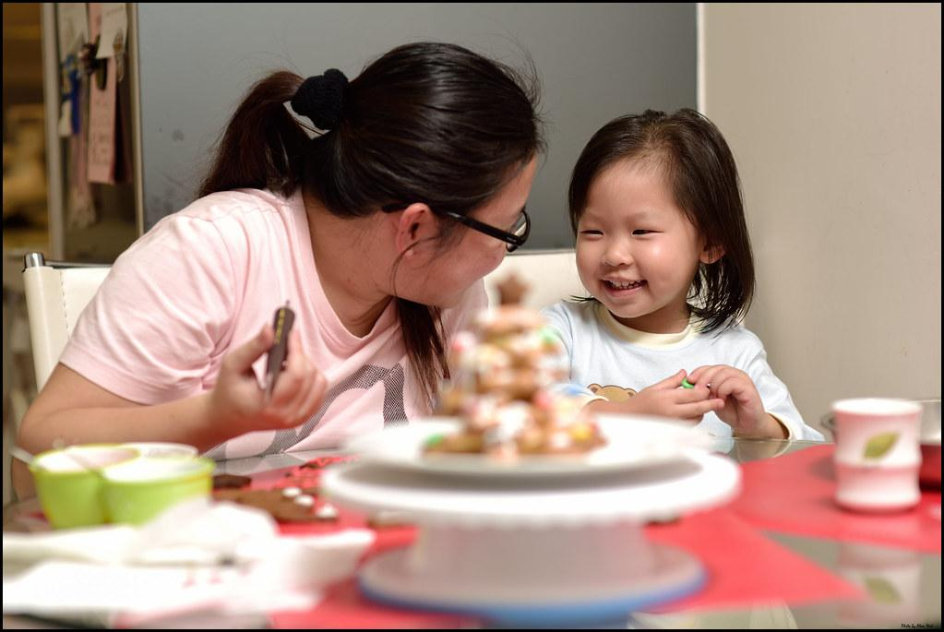
What can you as families do to help your children practice THINKING….especially while learning from home.
1. Be the learner that you want your child to be.
Learn something together like a new game or by searching together for information online.
Try a new recipe.
Make some mistakes. Learn together.

Slide 19
2. Plan a trip to the
Supermarket.
A practical way for elementary-age children to develop their analyse and evaluate is to help parents develop and write a grocery
shopping list….and then use it when shopping!!
Try a Thinking Routine like What Made You Choose That?

Slide 20
3. Organize a space and time for reading together.
With your child, find and furnish a well-lit, comfortable study place
that is free from distractions.
Try a Thinking Routine like
See Think Wonder
and encourage connection to
the main character

Slide 21
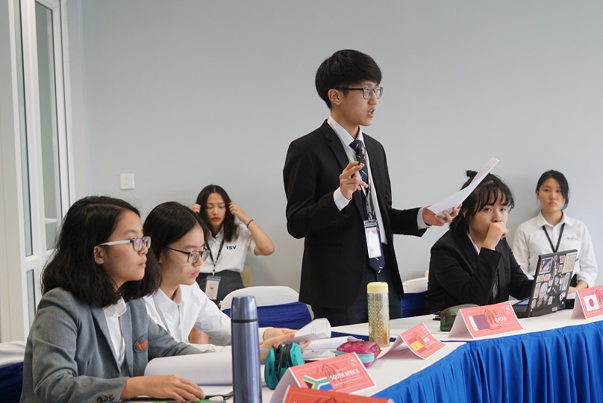
Question time

Slide 22
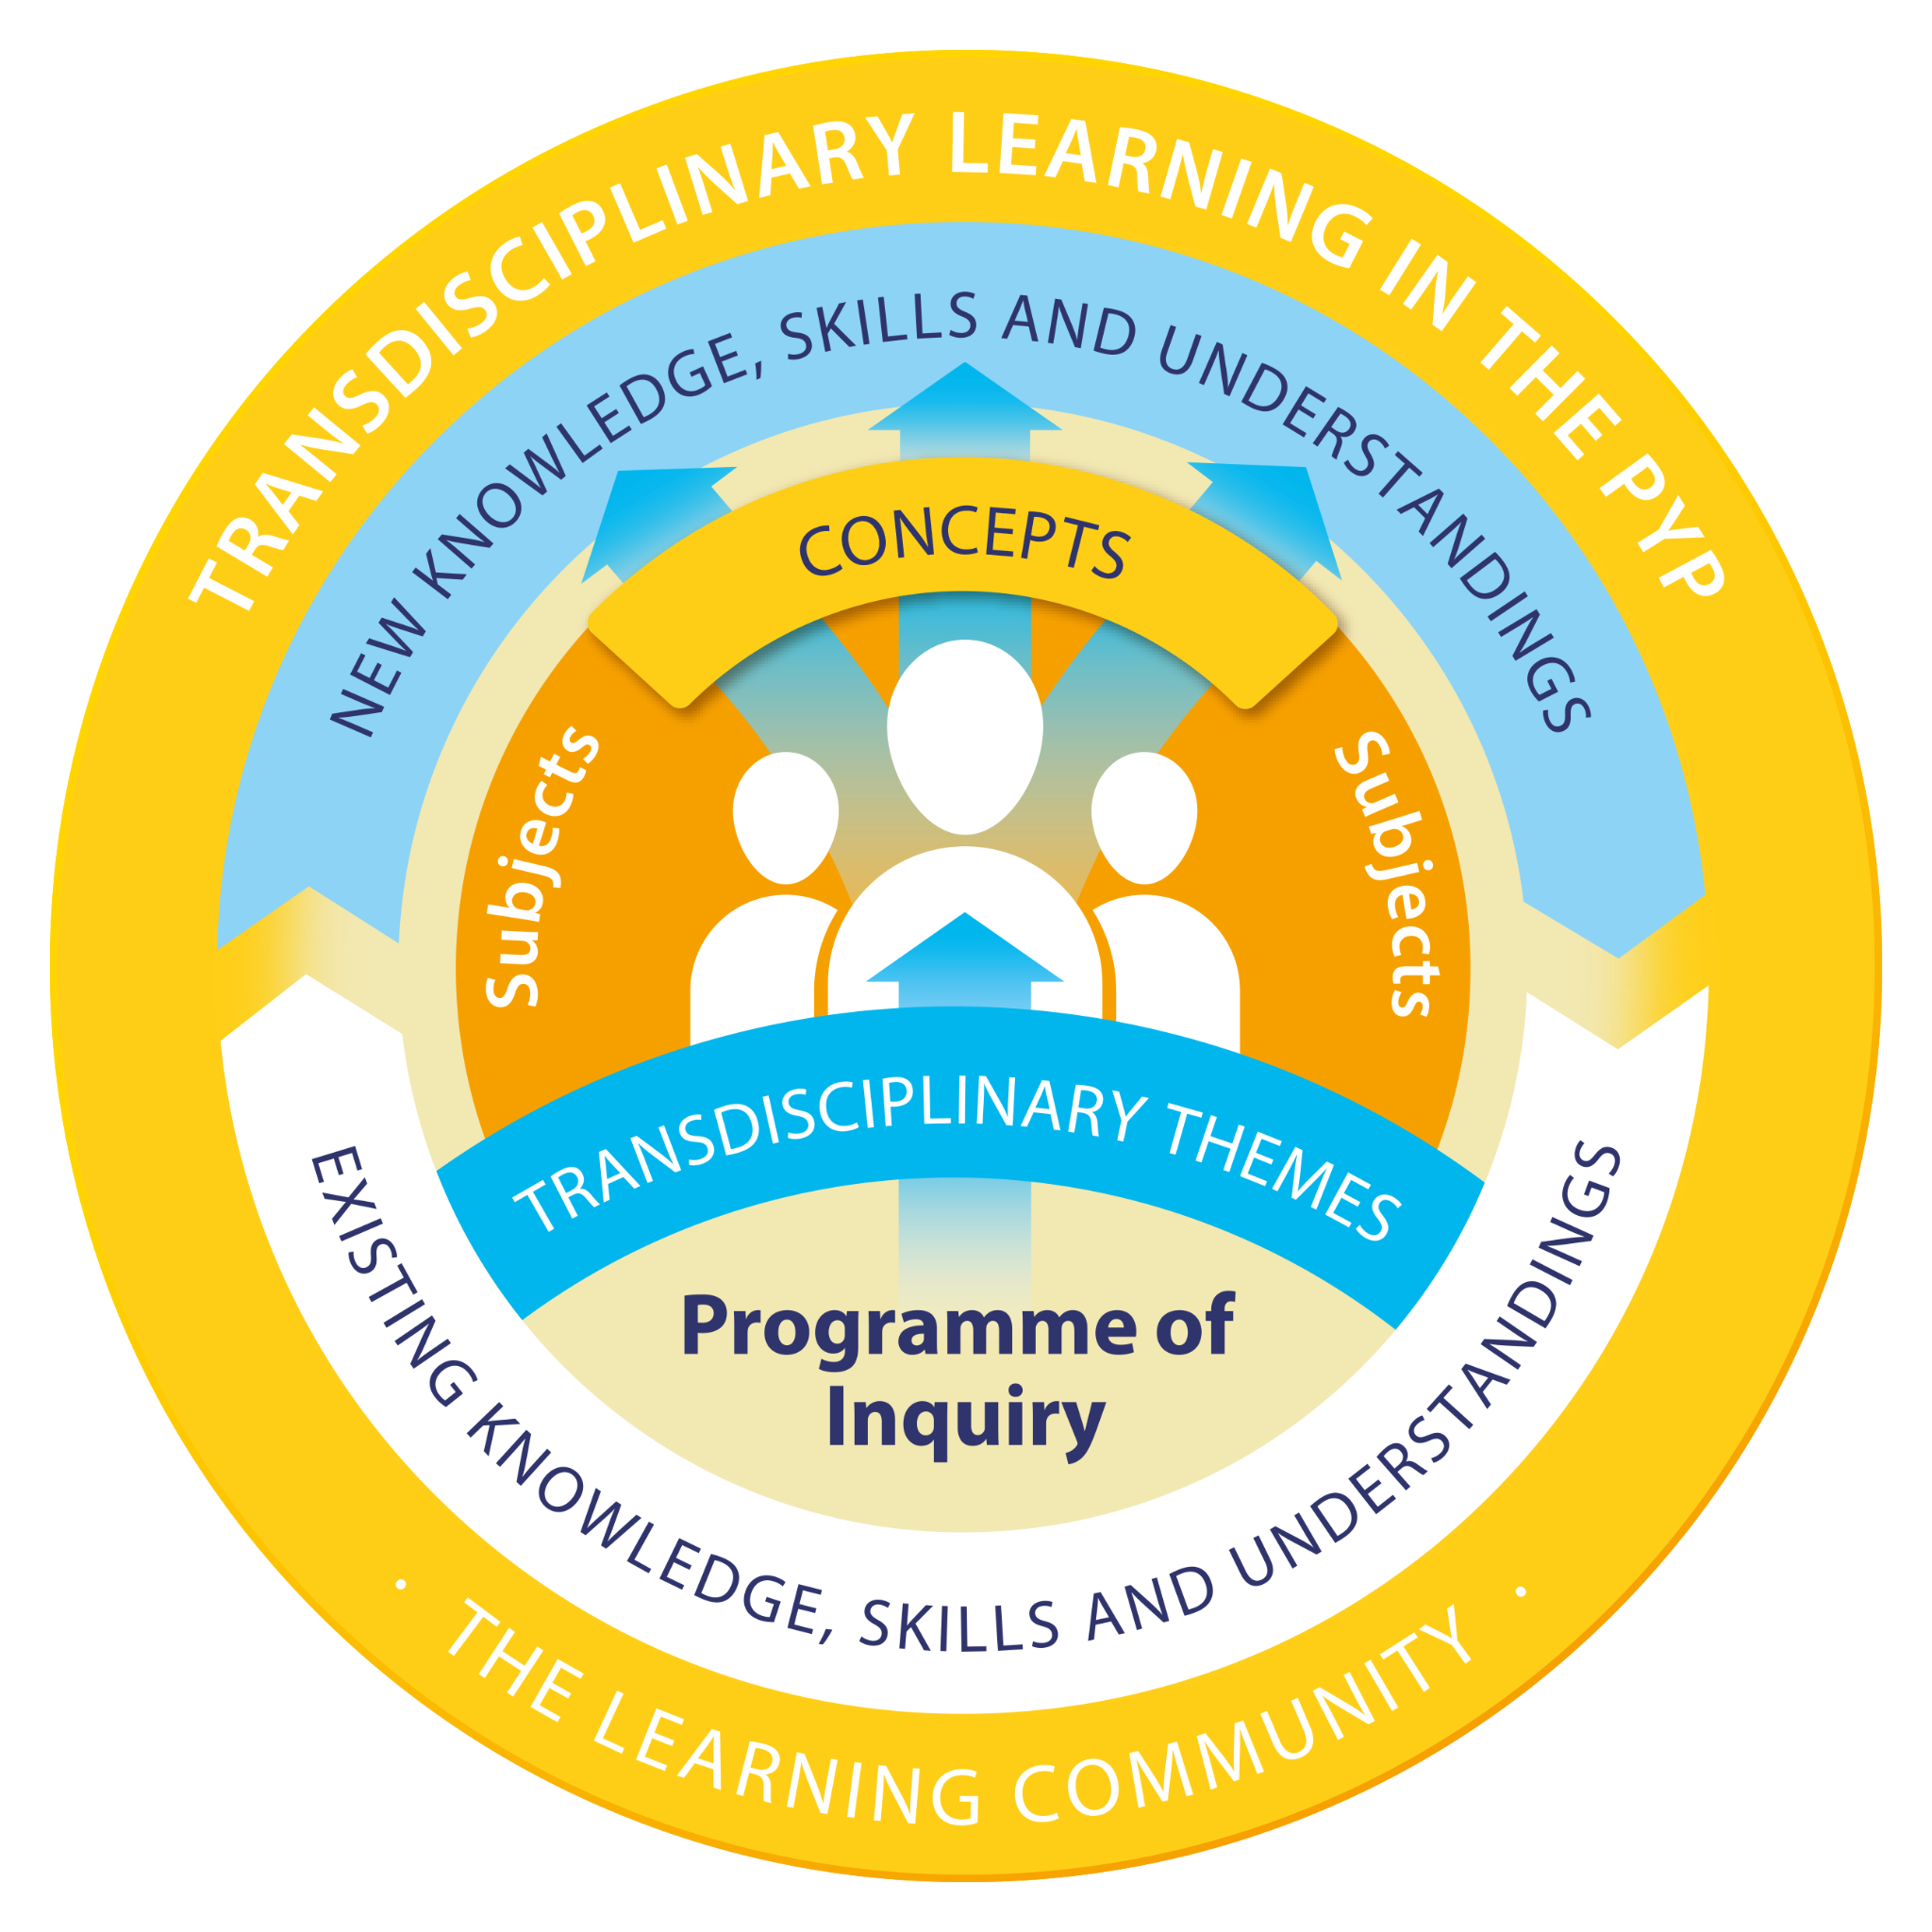
Useful online links from the IB
the learner
learning and teaching
the learning community

